Slide 1
Play Spaces that Make “Sense”
Using the Senses to Guide
Play- space Creation

Slide 2
Introductions
Melissa Gemeinhardt, M.Ed.
Special Instructor, Early Steps;
Certified School Counselor
Holly Bell, Ph.D.
Easterseals Louisiana- Director of Children’s Services
Early Steps Region 1 Service Point of Entry Office

Slide 3
Overview
Why using the Senses in design is important
Ways to tap into your “senses perspective”
Consider Children with Special Needs
Explore Elements of Design
Explore Elements of Comfort & Wonder
Importance of Elements of Surprise
Tying it all Together: Planning your Space

Slide 4
Quotes Exercise
Thinking About Space with Intention
Find a person who is new to you.
2 minutes to share and discuss 1st quote in relation to play-spaces.
On the signal discuss 2nd quote.
On the Signal switch partners; repeat.

Slide 5
Thinking About Space with Intention
Debrief-
What do the quotes tell us about Play Spaces?

Slide 6
Visualization Exercise
Discovering Spirit in Space
Listen to the guided visualization of 3 environments from childhood.
Write or draw your thoughts about the spaces you visualized.
Share your experience in groups of 3 or 4
Debrief with whole group.

Slide 7
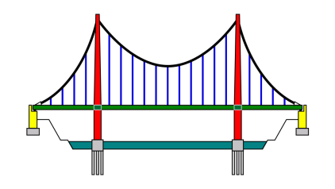
Crossing the bridge… Consider Those w/ Special Needs
Similarities between all children-
Variation often relates to the “DIF”:
D- duration
I-Intensity
F-frequency
Applies to both desirable & less desirable behaviors
Sometimes can be a coping mechanism or adaptation in response to specific need.

Slide 8
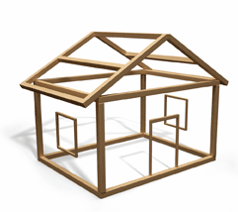
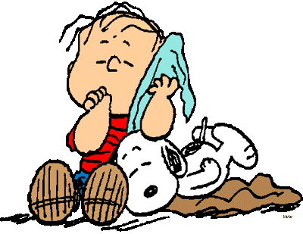
Elements of Space Design
Structure
Senses
Comfort
Wonder
Surprise

Slide 9
Structure
Features of the space itself- Built in.
Can include:
Sounds
Textures
Lighting
Air Movement
Colors
Patterns

Slide 10
Senses
Sensory Elements-
“Sensations of daily life together form a sensory mosaic that influences behavior and development” (Mount & Cavet, June 1995).

Slide 11
Senses cont.
Auditory Environment-
Tactile Environment-
Visual Environment-
Olfactory Environment-
-Take-Home Exercise #5: Asessing Play Centers

Slide 12
Senses Bonus*
Proprioceptive & Vestibular Systems
Proprioceptive System- definition
Vestibular System- definition
Keep These Systems in Awareness

Slide 13
Elements of Comfort
Provide a balance to the necessity of institutional pragmatism.
Provide comfort or security
Invite complex improvisational play and opportunities to practice caregiving or nurturing

Slide 14
Elements of Comfort, cont.
Nature-
Softness-
Home-
Quiet Spaces
Familiarity

Slide 15
Elements of Wonder
Changes in scale
Miniature-
“Just my Size”-
Colossal Scale
Microscopic-

Slide 16
Elements of Wonder Cont.
Realness-
Open-endedness-
Loose Parts-
Novelty-

Slide 17
Surprise
Surprise = Novelty or Specialness
Surprise, rarity or unusualness can be a motivator for play.
Open-ended
Fantastical
Magical

Slide 18
Comfort & Wonder Exercise
Thinking of you own play-spaces:
Rate each center based on the elements of Comfort & Wonder
Examine scores for possible balance

Slide 19
Conclusion/ Questions
Access to and the quality of activities are shaped by the spaces in which they take place.
The consideration of play environments through the senses can shape the quality of the experiences of, and thus the emotional impact on the children who play there.

Slide 20
Thank you!
Melissa Gemeinhardt
lissaluu@yahoo.com
Holly Bell
hbell@laeasterseals.com

