Slide 1
Movement in the Classroom- Impact on Reading Fluency
Gabrielle Browning

Slide 2
EURECA
EURECA stands for ‘Enhancing Undergraduate Research Endeavors & Creating Activities’.
In order to conduct research with the funding of EURECA you submit an application to members of the Undergraduate Research Advisory and Assessment Committees, and a panel of faculty peers.
These members evaluate the proposals and make recommendations to the Director of Undergraduate Research.
Requirements:
Minimum 2.75 GPA.
Take an additional class which elaborated on how to conduct research.
Attend all EURECA workshops, presentations, and forums.
Present results of your project at forums.

Slide 3
Rhythm Works
Rhythm Works is a rhythm and dance program that incorperates evidence-based practices from sensory intergration, applications to phusical skills, and behavioral strategies.
I learned how to
Identify & demonstrate developmentally appropriate choreography structure.
Choose activities/games that incorporate skills from the 5 developmental domains (motor, cognitive, self-help, social-emotional, communication) based on student skill level.
Identify and replicate rhythm patterns, musical sentences, and music theory/structure.
Identify antecedents, behaviors, & consequences, and effectively encourage desired adaptive responses.
Recognize the “learner-type” of each student and demonstrate the most complementary “teaching styles.”
Identify physical and cognitive challenges and demonstrate modifications of content based on the abilities of each student.

Slide 4
Prior research

Slide 5
Reading fluency is an imperative and fundamental skill used throughout PK-12th grade, as well as long after they graduate.
Reading fluency is often challenging for students with disabilities.
This causes students to feel intimidated, discouraged, and unmotivated by the thought of reading.
In the article “Two Methods for Developing Fluency” (Murray 1999)
Teachers are told repeated reading and voluntary reading could improve reading fluency.
Both explanations a key point is to have the kids engaged and motivated or neither of these methods will work.

Slide 6
According to the National Center for Education Statistics [NCES]
35% of students perform at or above proficient on standardized reading tests.
Up to 68% of students with disabilities read below the basic level.
In the state of New York during the 2011-2012 school year
Four out of the five students were not meeting the benchmark for the fluency (Cotter 2012).
Other research found “early movement experiences are beneficial to optimal brain development” (Gabbard 1998).
This is what inspired my research.
Finding the benefits and correlation of movement and reading.

Slide 7
My Method

Slide 8
Before implementing
the intervention
Received approval from Institutional Review Board (IRB).
Completed National Institutes of Health (NIH) training.
Found a school and special education class to allow this research to be conducted.
Within that class each student was given one minute to read as many words correctly as they could on a Raz-Kids Reading Fluency Benchmark Passage.

Slide 9
Conducting the intervention
For 30 minutes each week dance and movement was incorporated into the reading curriculum.
I provided students with the necessary equipment to make learning fun by appealing to their fun side.
I looked to answer two questions:
Will movement in the classroom increase reading fluency levels among students with disabilities?
How do students with disabilities’ rate of change for their reading fluency levels compare to students who did not use movement during their classroom lessons?

Slide 10
After implementing
the intervention
On the last day
Each student was given one minute to read as many words correctly as they could on the same Raz-Kids Reading Fluency Benchmark Passage.
This was to determine if movement in the classroom increases reading fluency levels among students with disabilities.
I compared reading fluency scores before and after the intervention took place.
I measured the efficiency dance and movement has on students with disabilities in elementary school.

Slide 11
Results

Slide 12
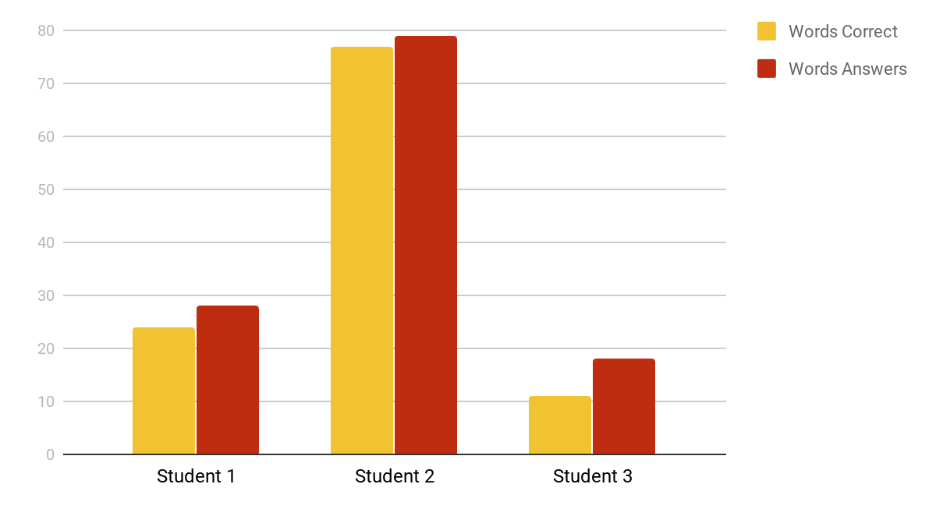
Pre-Test Results

Slide 13
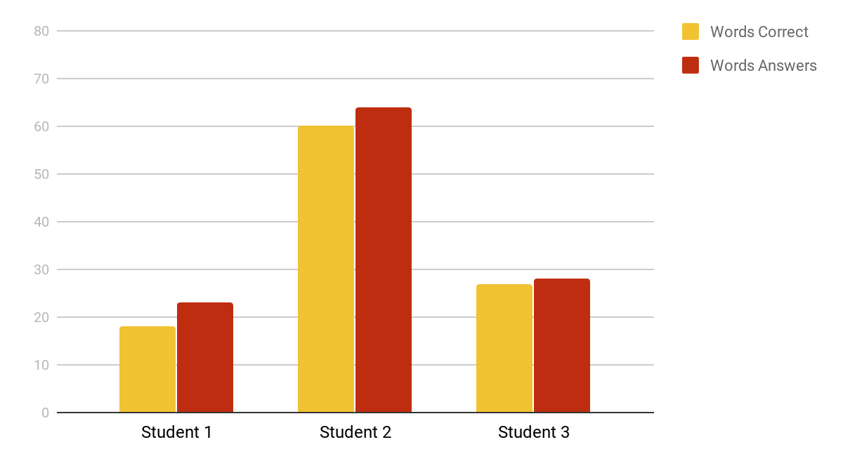
Post-Test Results

Slide 14
Results Explained
Reading fluency levels improved for one of the three students.
He went from having 61% reading fluency to 96%.
Before the intervention took place he read 18 words per minute, only getting 11 words correctly.
After the four weeks, he read 28 words per minute and getting 27 words correct.
The other student’s levels did not improve, but did not decrease enough to show academic harm.
Student 1 decreased by 7%.
Student 2 decreased by 4%.

Slide 15
Limitations
Small sample size
I only had three students participate.
The results might have differed if there were more students and a wider range of reading levels.
Limited time
I had trouble getting into the school so I had limited time to conduct research.
I had exactly four weeks to test, implement, and retest students.
Access
Since this looks specifically into reading fluency, I could only observe and implement during ELAR time, which was only allowed 30 minutes a day.
I had to make sure the lesson was focused around fluency rather than another area such as comprehension.
Self-reported data
The pre and post test was done by the teacher.
I was not in the class full time and the teacher did fluency tests every week on her own schedule.
Therefore, the data was not independently verified.

Slide 16
By incorporating dance and movement into the curriculum 30 minutes a week, the students were able to work on reading fluency without the pressure assignments and typical school work provides.

Slide 17
Future Research

Slide 18
Extend the amount of time
Increase from 30 minutes once a week to 20 minutes three times a week.
Increase from four weeks to eight weeks.
More than just learning disabilities
Take data on students with other disabilities such as autism, down syndrome, ADHD, ID, etc.
Other ages
Implement and take data on another grade, whether that be higher or lower.
Other reading levels
Implement and take data on students with higher than a kinder or first grade reading level.

Slide 19
How can this help teachers?

Slide 20
Initial Concerns
As teachers, it can be difficult to implement another intervention for one student when you already have so many in place.
It takes time
Time to plan
Time to implement
Time to check for progress
You have 20+ other students you have to plan for
Your student may be reluctant to be apart of another intervention

Slide 21
How can this help teachers?
However, this is an intervention you don't have to do additional planning than you already do for lessons.
It can be easily added into your lesson
Every student in your class can be involved
The student won’t have a clue this is to help them with fluency

Slide 22
Questions?

